Slide 1
DYNAMIC PROGRAMMING

Slide 2
Introduction
Dynamic Programming is an algorithm design technique for optimization problems: often minimizing or maximizing.
Solves problems by combining the solutions to subproblems that contain common sub-sub-problems.

Slide 3
DP can be applied when the solution of a problem includes solutions to subproblems
We need to find a recursive formula for the solution
We can recursively solve subproblems, starting from the trivial case, and save their solutions in memory
In the end we’ll get the solution of the whole problem

Slide 4
Steps
Steps to Designing a Dynamic Programming Algorithm
1. Characterize optimal sub-structure
2. Recursively define the value of an optimal solution
3. Compute the value bottom up
4. (if needed) Construct an optimal solution

Slide 5
Diff. B/w Dynamic Programming and Divide & Conquer:
Divide-and-conquer algorithms split a problem into separate subproblems, solve the subproblems, and combine the results for a solution to the original problem.
Example: Quicksort, Mergesort, Binary search
Divide-and-conquer algorithms can be thought of as top-down algorithms
Dynamic Programming split a problem into subproblems, some of which are common, solve the subproblems, and combine the results for a solution to the original problem.
Example: Matrix Chain Multiplication, Longest Common Subsequence
Dynamic programming can be thought of as bottom-up

Slide 6
Diff. B/w Dynamic Programming and Divide & Conquer (Cont…):
In divide and conquer, subproblems are independent.
Divide & Conquer solutions are simple as compared to Dynamic programming .
Divide & Conquer can be used for any kind of problems.
Only one decision sequence is ever generated
In Dynamic Programming , subproblems are not independent.
Dynamic programming solutions can often be quite complex and tricky.
Dynamic programming is generally used for Optimization Problems.
Many decision sequences may be generated.

Slide 7
Multistage graph
Computing a binomial coefficient
Matrix-chain multiplication
Longest Common Subsequence
0/1 Knapsack
The Traveling Salesperson Problem
Warshall’s algorithm for transitive closure
Floyd’s algorithm for all-pairs shortest paths

Slide 8
MULTISTAGE GRAPH
Multistage Graph adalah Graph dengan sifat-sifat khusus :
Graph berarah (Directed Graph)
Setiap edge-nya memiliki weight (bobot)
Hanya terdapat 1 source (disebut s) dan 1 sink (disebut t)
Lintasan dari source ke sink terdiri atas beberapa stage V1 sampai Vk
Semua edge menghubungkan node di Vi ke sebuah node di Vi + 1 dimana 1 ≤ i ≤ k
Terdapat stage sebanyak k, dimana k ≥ 2
Setiap path dari s ke t merupakan konsekuensi dari pilihan sebanyak k–2
Multistage Graph merupakan bentuk permodelan yang dapat digunakan untuk menyelesaikan berbagai permasalahan dunia nyata.
Contoh : pemilihan project untuk mendapatkan keuntungan maksimal; serta pemilihan langkah-langkah yang harus dipilih dalam menyelesaikan sebuah tugas.

Slide 9
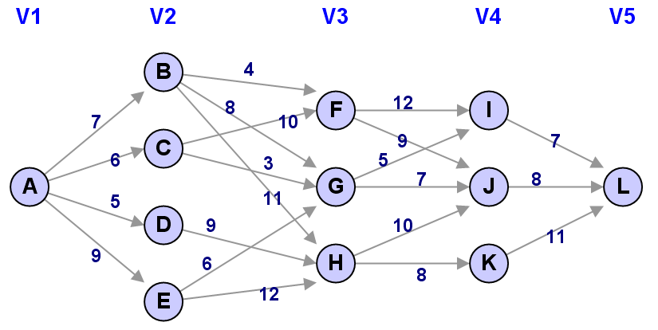
MULTISTAGE GRAPH PROBLEM
Multistage Graph Problem :
Problem mencari lintasan terpendek dari source ke sink pada sebuah Multistage Graph.
Problem ini merupakan salah satu contoh penerapan yang bagus dari Dynamic Programming.

Slide 10
DP PADA MULTISTAGE GRAPH PROBLEM
Teknik penyelesaian Multistage Graph Problem dengan Dynamic Programming berdasar pada sebuah prinsip bahwa jalur terpendek dari satu node (awal atau akhir) ke node lain di stage tertentu merupakan jalur terpendek dari stage sebelumnya ditambah panjang salah satu edge penghubung stage.
Metode Forward
Menghitung jarak ke depan (menuju sink)
Metode Backward
Menghitung jarak ke belakang (dari source)

Slide 11
METODE FORWARD
Prinsip : analisis dilakukan dengan menghitung path (jalur) dari suatu node ke sink
Rumus : cost(i,j) = min{c(j,k) + cost(i+1,k)}
Perhitungan dimulai dari node-node di stage k–2
cost(i,j) artinya panjang lintasan dari node j di stage i menuju sink (t)
c(j,l) artinya panjang lintasan dari node j ke node l
Pelajari langkah-langkah algoritma secara detil pada ilustrasi 7.8 dan ilustrasi 7.9

Slide 12
METODE FORWARD
cost(4,I) = c(I,L) = 7
cost(4,J) = c(J,L) = 8
cost(4,K) = c(K,L) = 11
cost(3,F) = min { c(F,I) + cost(4,I) | c(F,J) + cost(4,J) }
cost(3,F) = min { 12 + 7 | 9 + 8 } = 17
cost(3,G) = min { c(G,I) + cost(4,I) | c(G,J) + cost(4,J) }
cost(3,G) = min { 5 + 7 | 7 + 8 } = 12
cost(3,H) = min { c(H,J) + cost(4,J) | c(H,K) + cost(4,K) }
cost(3,H) = min { 10 + 8 | 8 + 11 } = 18
cost(2,B) = min { c(B,F) + cost(3,F) | c(B,G) + cost(3,G) | c(B,H) + cost(3,H) }
cost(2,B) = min { 4 + 17 | 8 + 12 | 11 + 18 } = 20
cost(2,C) = min { c(C,F) + cost(3,F) | c(C,G) + cost(3,G) }
cost(2,C) = min { 10 + 17 | 3 + 12 } = 15
cost(2,D) = min { c(D,H) + cost(3,H) }
cost(2,D) = min { 9 + 18 } = 27
cost(2,E) = min { c(E,G) + cost(3,G) | c(E,H) + cost(3,H) }
cost(2,E) = min { 6 + 12 | 12 + 18 } = 18
cost(1,A) = min { c(A,B) + cost(2,B) | c(A,C) + cost(2,C) | c(A,D) + cost(2,D) | c(A,E) + cost(2,E) }
cost(1,A) = min { 7 + 20 | 6 + 15 | 5 + 27 | 9 + 18 } = 21
Rute terpendek adalah A-C-G-I-L dengan panjang 21

Slide 13
METODE BACKWARD
Prinsip : analisis dilakukan dengan menghitung path (jalur) dari source ke suatu node
Rumus : bcost(i,j) = min{bcost(i–1,l) + c(l,j)}
Perhitungan dimulai dari node-node di stage 3
bcost(i,j) artinya panjang lintasan backward dari source (s) menuju node j di stage i
c(j,l) artinya panjang lintasan dari node j ke node l
Pelajari langkah-langkah algoritma secara detil pada ilustrasi 7.11 dan ilustrasi 7.12

Slide 14
METODE BACKWARD
bcost(2,B) = c(A,B) = 7
bcost(2,C) = c(A,C) = 6
bcost(2,D) = c(A,D) = 5
bcost(2,E) = c(A,E) = 9.
bcost(3,F) = min { c(B,F) + bcost(2,B) | c(C,F) + bcost(2,C) }
bcost(3,F) = min { 4 + 7 | 10 + 6 } = 11
bcost(3,G) = min { c(B,G) + bcost(2,B) | c(C,G) + bcost(2,C) | c(E,G) + bcost(2,E) }
bcost(3,G) = min { 8 + 7 | 3 + 6 | 6 + 9 } = 9
bcost(3,H) = min { c(B,H) + bcost(2,B) | c(D,H) + bcost(2,D) | c(E,H) + bcost(2,E) }
bcost(3,H) = min { 11 + 7 | 9 + 5 | 12 + 9 } = 14
bcost(4,I) = min { c(F,I) + bcost(3,F) | c(G,I) + bcost(3,G) }
bcost(4,I) = min { 12 + 11 | 5 + 9 } = 14
bcost(4,J) = min { c(F,J) + bcost(3,F) | c(G,J) + bcost(3,G) | c(H,J) + bcost(3,H) }
bcost(4,J) = min { 9 + 11 | 7 + 9 | 10 + 14 } = 16
bcost(4,K) = min { c(H,K) + cost(3,H) }
bcost(4,K) = min { 8 + 14 } = 22
bcost(5,L) = min { c(I,L) + bcost(4,I) | c(J,L) + bcost(4,J) | c(K,L) + bcost(4,K) }
bcost(5,L) = min { 7 + 14 | 8 + 16 | 11 + 22 } = 21
Rute terpendek adalah A-C-G-I-L dengan panjang 21

Slide 15
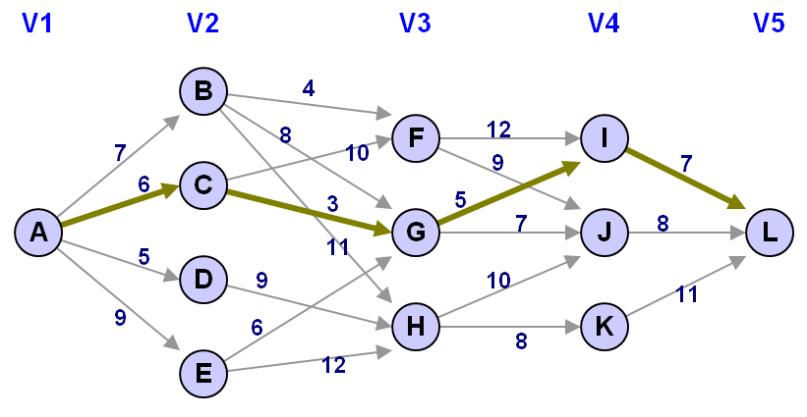
RUTE TERPENDEK MULTISTAGE GRAPH

Slide 16
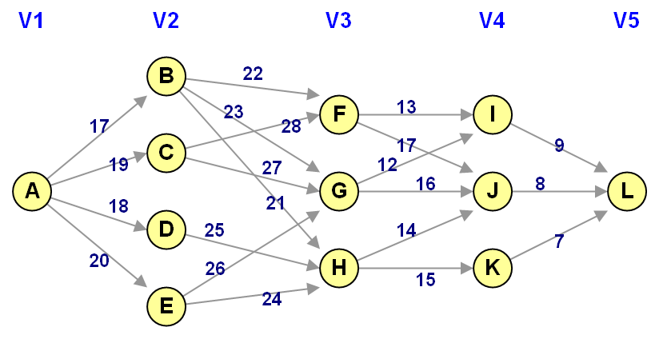
LATIHAN
Tentukan jalur terpendek dari node A ke node L dengan Dynamic Programming (metode forward dan metode backward) !

Slide 17
Matrix-chain Multiplication
Suppose we have a sequence or chain A₁, A₂, …, A_{n} of n matrices to be multiplied
That is, we want to compute the product A₁A₂…A_{n}
There are many possible ways (parenthesizations) to compute the product

Slide 18
Matrix-chain Multiplication
Example: consider the chain A₁, A₂, A₃, A₄ of 4 matrices
Let us compute the product A₁A₂A₃A₄
There are 5 possible ways:
(A₁(A₂(A₃A₄)))
(A₁((A₂A₃)A₄))
((A₁A₂)(A₃A₄))
((A₁(A₂A₃))A₄)
(((A₁A₂)A₃)A₄)

Slide 19
Matrix-chain Multiplication
To compute the number of scalar multiplications necessary, we must know:
Algorithm to multiply two matrices
Matrix dimensions
Can you write the algorithm to multiply two matrices?

Slide 20
Algorithm to Multiply 2 Matrices
Input: Matrices A_{p×q} and B_{q×r} (with dimensions p×q and q×r)
Result: Matrix C_{p×r} resulting from the product A·B
MATRIX-MULTIPLY(A_{p×q} , B_{q×r})
1. for i ← 1 to p
2. for j ← 1 to r
3. C[i, j] ← 0
4. for k ← 1 to q
5. C[i, j] ← C[i, j] + A[i, k] · B[k, j]
6. return C
Scalar multiplication in line 5 dominates time to compute CNumber of scalar multiplications = pqr

Slide 21
Matrix-chain Multiplication
Example: Consider three matrices A_{10×100}, B_{100×5}, and C_{5×50}
There are 2 ways to parenthesize
((AB)C) = D_{10×5} · C_{5×50}
AB ⇒ 10·100·5=5,000 scalar multiplications
DC ⇒ 10·5·50 =2,500 scalar multiplications
(A(BC)) = A_{10×100} · E_{100×50}
BC ⇒ 100·5·50=25,000 scalar multiplications
AE ⇒ 10·100·50 =50,000 scalar multiplications
Total: 7,500
Total: 75,000

Slide 22
Matrix-chain Multiplication
Matrix-chain multiplication problem
Given a chain A₁, A₂, …, A_{n} of n matrices, where for i=1, 2, …, n, matrix A_{i} has dimension p_{i-1}×p_{i}
Parenthesize the product A₁A₂…A_{n} such that the total number of scalar multiplications is minimized
Brute force method of exhaustive search takes time exponential in n

Slide 23
Dynamic Programming Approach
The structure of an optimal solution
Let us use the notation A_{i..j} for the matrix that results from the product A_{i} A_{i+1} … A_{j}
An optimal parenthesization of the product A₁A₂…A_{n} splits the product between A_{k} and A_{k+1} for some integer k where1 ≤ k < n
First compute matrices A_{1..k} and A_{k+1..n} ; then multiply them to get the final matrix A_{1..n}

Slide 24
Dynamic Programming Approach
Key observation: parenthesizations of the subchains A₁A₂…A_{k} and A_{k+1}A_{k+2}…A_{n} must also be optimal if the parenthesization of the chain A₁A₂…A_{n} is optimal (why?)
That is, the optimal solution to the problem contains within it the optimal solution to subproblems

Slide 25
Dynamic Programming Approach
Recursive definition of the value of an optimal solution
Let m[i, j] be the minimum number of scalar multiplications necessary to compute A_{i..j}
Minimum cost to compute A_{1..n} is m[1, n]
Suppose the optimal parenthesization of A_{i..j} splits the product between A_{k} and A_{k+1} for some integer k where i ≤ k < j

Slide 26
Dynamic Programming ApproacH
A_{i..j} = (A_{i} A_{i+1}…A_{k})·(A_{k+1}A_{k+2}…A_{j})= A_{i..k} · A_{k+1..j}
Cost of computing A_{i..j} = cost of computing A_{i..k} + cost of computing A_{k+1..j} + cost of multiplying A_{i..k} and A_{k+1..j}
Cost of multiplying A_{i..k} and A_{k+1..j} is p_{i-1}p_{k} p_{j}
m[i, j ] = m[i, k] + m[k+1, j ] + p_{i-1}p_{k} p_{j} for i ≤ k < j
m[i, i ] = 0 for i=1,2,…,n

Slide 27
Dynamic Programming ApproacH
But… optimal parenthesization occurs at one value of k among all possible i ≤ k < j
Check all these and select the best one
0 if i=j
m[i, j ] =
min {m[i, k] + m[k+1, j ] + p_{i-1}p_{k} p_{j} } if i<j
i ≤ k< j

Slide 28
Dynamic Programming ApproacH
To keep track of how to construct an optimal solution, we use a table s
s[i, j ] = value of k at which Ai Ai+1 … Aj is split for optimal parenthesization
Algorithm: next slide
First computes costs for chains of length l=1
Then for chains of length l=2,3, … and so on
Computes the optimal cost bottom-up

Slide 29
Algorithm to Compute Optimal Cost
Input: Array p[0…n] containing matrix dimensions and n
Result: Minimum-cost table m and split table s
MATRIX-CHAIN-ORDER(p[ ], n)
for i ← 1 to n
m[i, i] ← 0
for l ← 2 to n
for i ← 1 to n-l+1
j ← i+l-1
m[i, j] ← ∞
for k ← i to j-1
q ← m[i, k] + m[k+1, j] + p[i-1] p[k] p[j]
if q < m[i, j]
m[i, j] ← q
s[i, j] ← k
return m and s
Takes O(n³) time
Requires O(n²) space

Slide 30
Constructing Optimal Solution
Our algorithm computes the minimum-cost table m and the split table s
The optimal solution can be constructed from the split table s
Each entry s[i, j ]=k shows where to split the product Ai Ai+1 … Aj for the minimum cost

Slide 31
Example
Show how to multiply this matrix chain optimally
Solution on the board
Minimum cost 15,125
Optimal parenthesization ((A1(A2A3))((A4 A5)A6))
Matrix | Dimension
A₁ | 30×35
A₂ | 35×15
A₃ | 15×5
A₄ | 5×10
A₅ | 10×20
A₆ | 20×25

Slide 32
Matrix-chain multiplication
n matrices A1, A2, …, An with size
p0 × p1, p1 × p2, p2 × p3, …, pn-1 × pn
To determine the multiplication order such that # of scalar multiplications is minimized.
To compute Ai × Ai+1, we need pi-1pipi+1 scalar multiplications.
e.g. n=4, A1: 3 × 5, A2: 5 × 4, A3: 4 × 2, A4: 2 × 5
((A1 × A2) × A3) × A4, # of scalar multiplications:
3 * 5 * 4 + 3 * 4 * 2 + 3 * 2 * 5 = 114
(A1 × (A2 × A3)) × A4, # of scalar multiplications:
3 * 5 * 2 + 5 * 4 * 2 + 3 * 2 * 5 = 100
(A1 × A2) × (A3 × A4), # of scalar multiplications:
3 * 5 * 4 + 3 * 4 * 5 + 4 * 2 * 5 = 160

Slide 33
Let m(i, j) denote the minimum cost for computing
A_{i} × A_{i+1} × … × A_{j}
Computation sequence :
Time complexity : O(n³)

